Slide 1

B.M.S COLLEGE OF ENGINEERING (Autonomous College Affiliated to Visvesvaraya Technological University, Belgaum) Bull Temple Road, Basavanagudi, Bangalore-560019 MINI PROJECT(2020-21) Submitted as a partial fulfilment of the course ELECTRICITY GENERATION FROM PIEZOELECTRIC FORCE SENSOR SUBMITTED BY THE BATCH MPI_ : 44 Student’s Name USN 1.Niteeshkumar H V 1BM19EC098 2. Nitesh R 1BM19 EC099 3. Padmaj U Naik 1BM19EC101 4. Pavan Kumar M 1BM19EC102

Slide 2
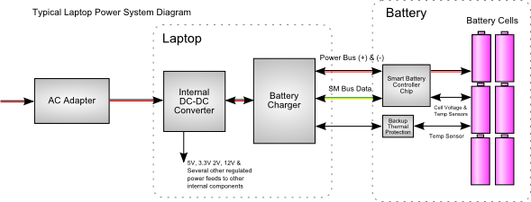

Existing System
In today world electronic devices have become a part and parcel of our daily life.
All the electronic devices are driven by battery and need electricity to get charged.
3. Among these device’s laptop is also need electricity to get charged on regular basis for proper working.
4.Once laptop get charged fully and in case, we use the laptop continuously then laptop will get discharged within 5-6 hour.
5.In some remote areas there is no proper supply of electricity or
while travelling long distance we don’t have access to proper
Power supply.

Slide 3

Hardware required
Piezoelectric material: The main hardware required is
suitable piezoelectric material(which produce AC voltage
when we apply stress or force on it).
2.Diode(1N4007G): It’s a semiconductor device. It allows the current to flow through in only one direction.
3.Capacitor(1U F): It’s used for both storage as well as amplification process.
4. Dummy Keyboard
5.Hook up wires
6. Multi meter
7. Soldering set

Slide 4
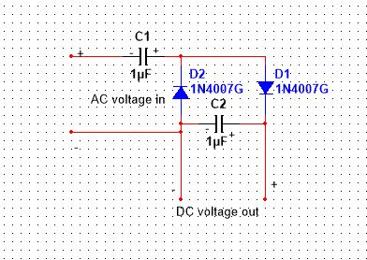
AC TO DC Conversion And Amplification
We will convert the AC produced from the piezo material to DC using Villard cascade(Voltage multiplier)
We use Villard cascade instead of rectifier because the voltage produced in the rectifier is very low and circuit is also complex.
Villard cascade is also called as voltage multiplier. A voltage multiplier is an electrical circuit that converts AC electrical power from a lower voltage to a higher DC voltage, typically using a network of capacitors and diodes.
In our experiment we just used two pair of capacitor and diode, so the output voltage produced is double and output voltage is depends on no of pair of diode and capacitor.

Slide 5
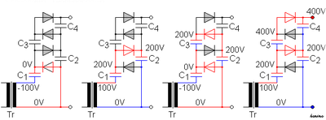
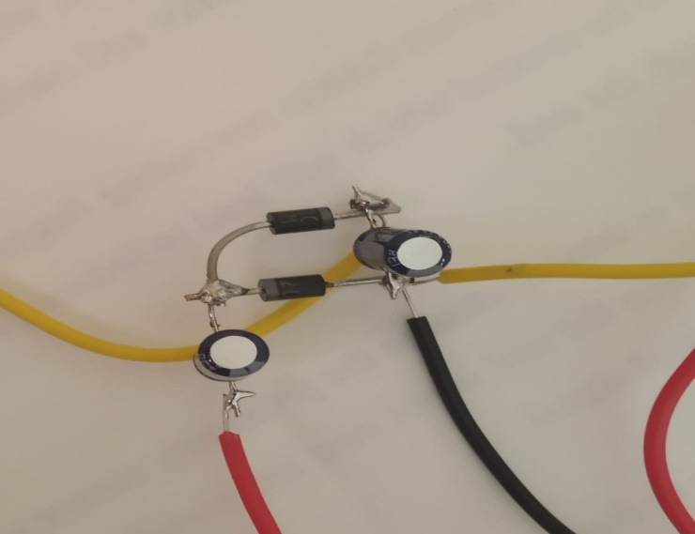
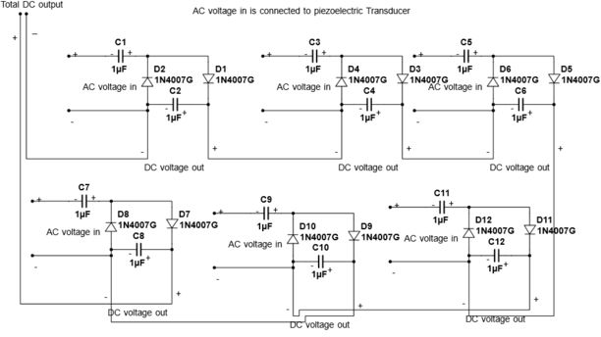
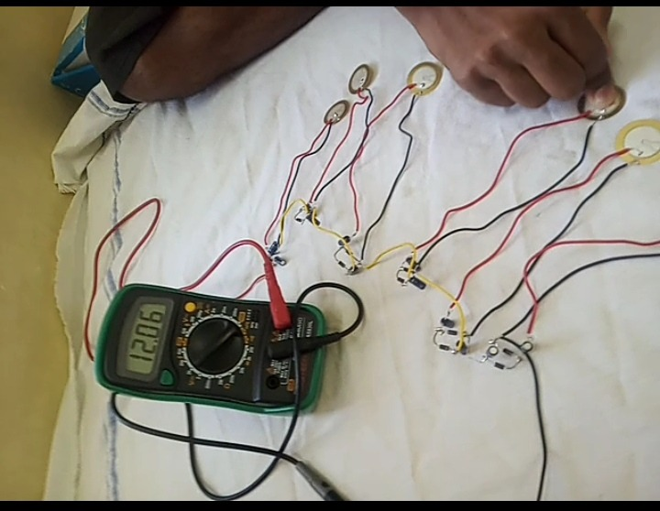
Figure 1
Figure 2
Figure 3
Figure 4

